Slide 1
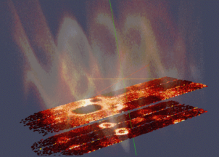
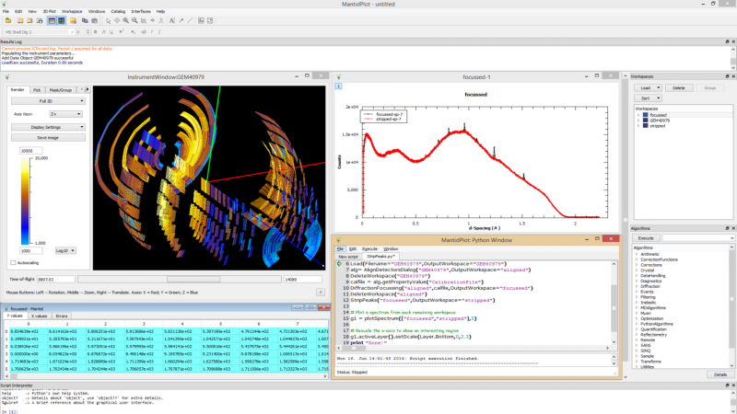
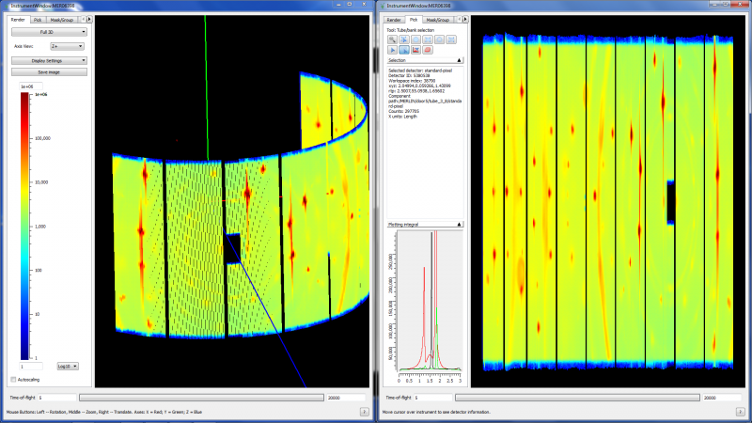

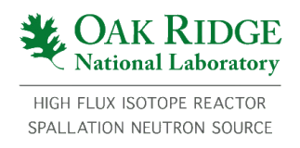


The Mantid Project
Aims
Data reduction/analysis framework for neutron scattering and muon experiments
Without restricting the needs of the instrument scientists
Cross-platform
Easily extensible
Freely redistributable
Open source
Adoption
3 Partner Facilities
9 Contributing Organisation
In use on 52 instruments worldwide
Notes:
So Neutron scattering is very powerful, but without software to help understand the results of these large instruments they are worthless

